Slide 1
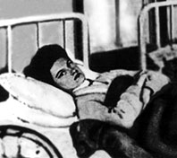
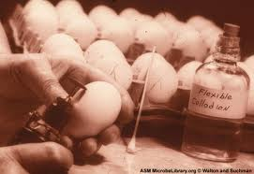
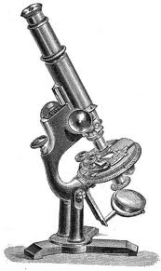
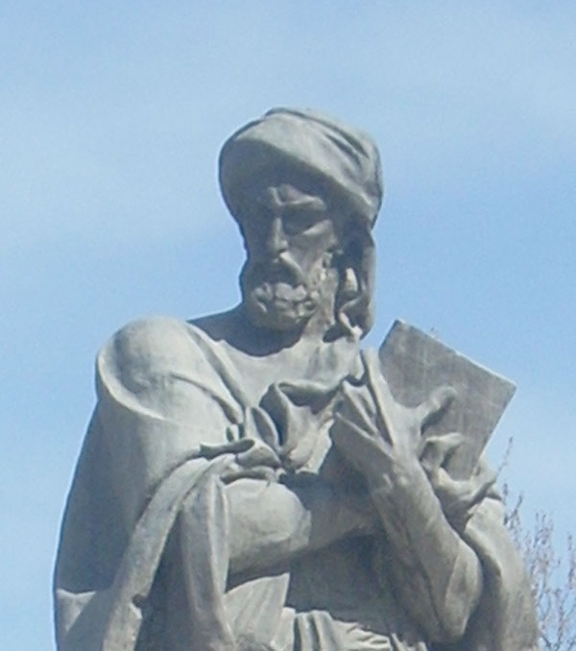
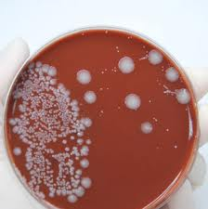
Infectious Diseases
Lesson 2.2

Slide 2
Lesson Objectives:
After finishing today’s lesson you will be able to:
explain why it was hard to identify the source of an infectious disease before people knew they were caused by microbes.
explain where microbes come from.
describe why viruses can pass through bacterial filters.

Slide 3
Do Now
Where do infectious microbes come from?
- Miasma - before we could ‘see’ microbes people believed diseases were caused by pollution or a noxious form of "bad air".
- Germ Theory - today we know microbes arise form microbes.

Slide 4
Ghost Map Activity
A cholera outbreak in Soho, London in 1854 had grave impacts on the community.
Use the ghost map reading in the worksheet to try to identify the source.

Slide 5
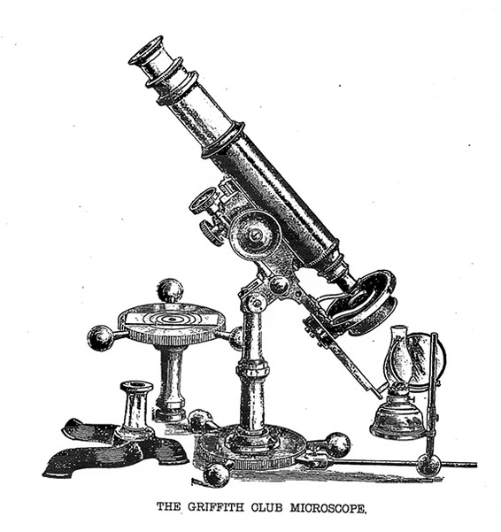
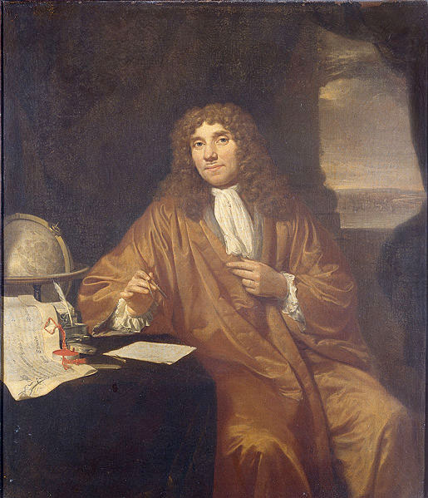
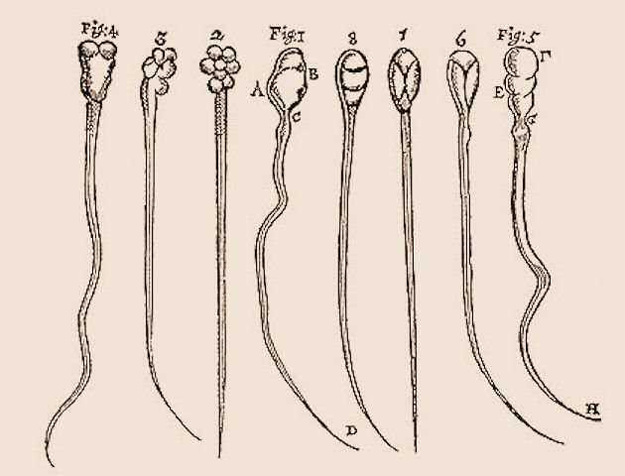
Discussion- The discovery of microbes
Drawings of dog and rabbit sperm
Antonie van Leeuwenhoek

Slide 6
Looking at microbes
First to see them: Antonie van Leeuwenhoek
Drawings of dog and rabbit sperm

Slide 7
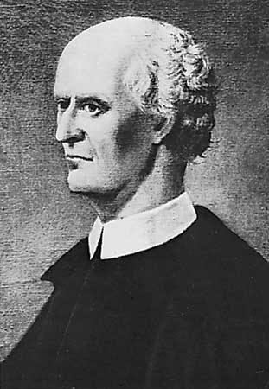
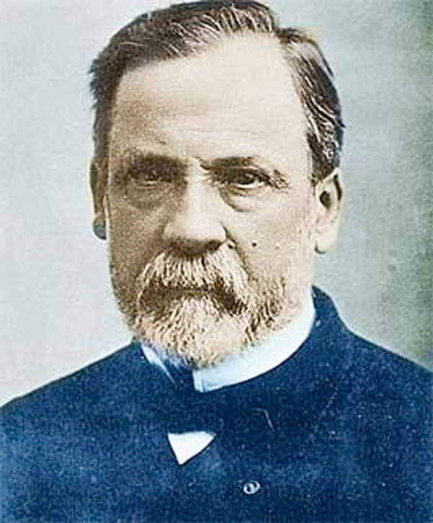
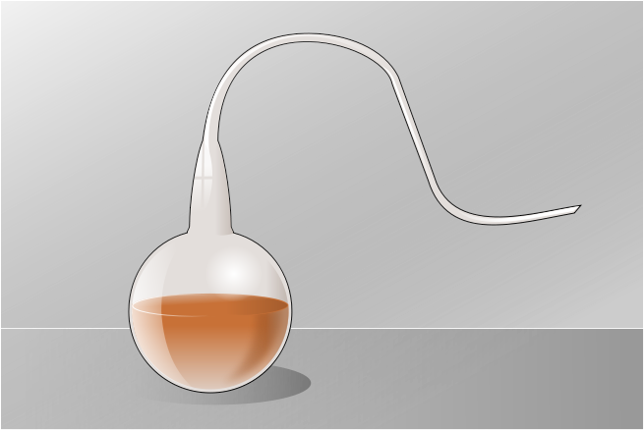
Where did microbes come from?
Lazzaro Spallazani:
Microbes could not grow spontaneously in sterile broth!
Pasteur did the key experiment…
gases only
air (gases, dust, microbes)
dust + microbes
sterile broth
Pasteur let the light gases in the air into the broth but kept the heavy dust with
the microbes stuck in the neck called the ‘Swan’s neck.’ The result: no growth!
Notes:
Pasteur proved that even when oxygen was present microbes will still not grow in sterile broth ….

Slide 8
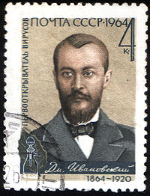
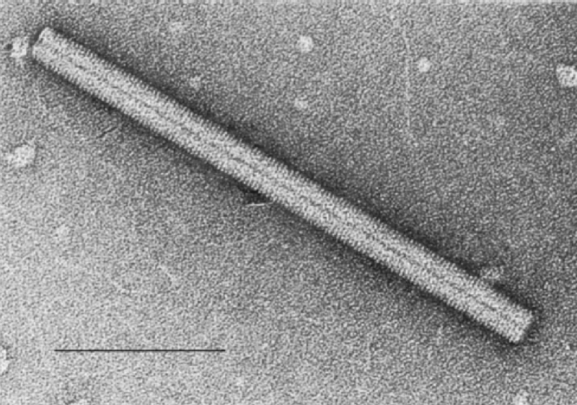
How did scientists discover agents that were smaller than bacteria? A small problem of viruses: too small to be seen under a light microscope.
Mixture of
Bacteria and
Viruses
Filter with
pores
Filtration
Tobacco mosaic virus
Bacteria are too big and
get stuck in the filter.
Viruses are smaller than the
pores and go through easily.
Dimitri Ivanovski

Slide 9
Wrap Up
If you think a disease is caused by an infectious agent, how would you find the microbe?
Where would you look?

Slide 10
Homework
Look up one example of an extreme environment that bacteria grow in. Write one paragraph about the environment and the bacterium. Don’t forget to cite your sources.

